Slide 1
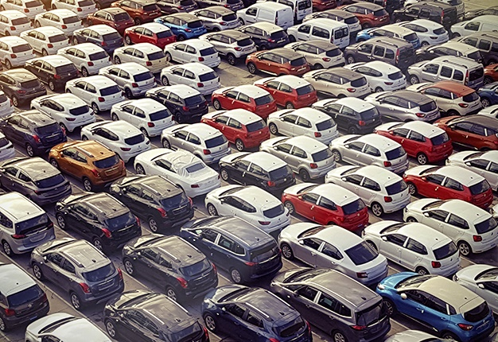

Used Cars Price Prediction Based In KSA Misk-DSI-2022
Yousef al otaibi
Instructors: Rick scavetta, Lujain felemban

Slide 2
Topics to be covered
Project Overview
Steps Carried On In This Project
Challenges
Limitations
Conclusion
Future work
Steps Carried On In This Project
Challenges
Limitations
Conclusion

Slide 3
Project Overview
Problem statement:
Sales of used cars in KSA are extremely increasing, prices are also becoming high. It’s in need to have a predictive system that will help in minimizing price manipulation of used cars.
Solution:
Collect data from a reliable source.
Study multiple features that influence car prices.
Build & deploy a predictive model that will help both buyers and sellers.

Slide 4
Steps carried on in this project
Data Collection
- Web Scraping
Data Pre-Processing
- Data Description
- Data Cleaning
Model Building
- Evaluating and testing multiple models
Model Deployment
- Building the website
- Deploying the model

Slide 5
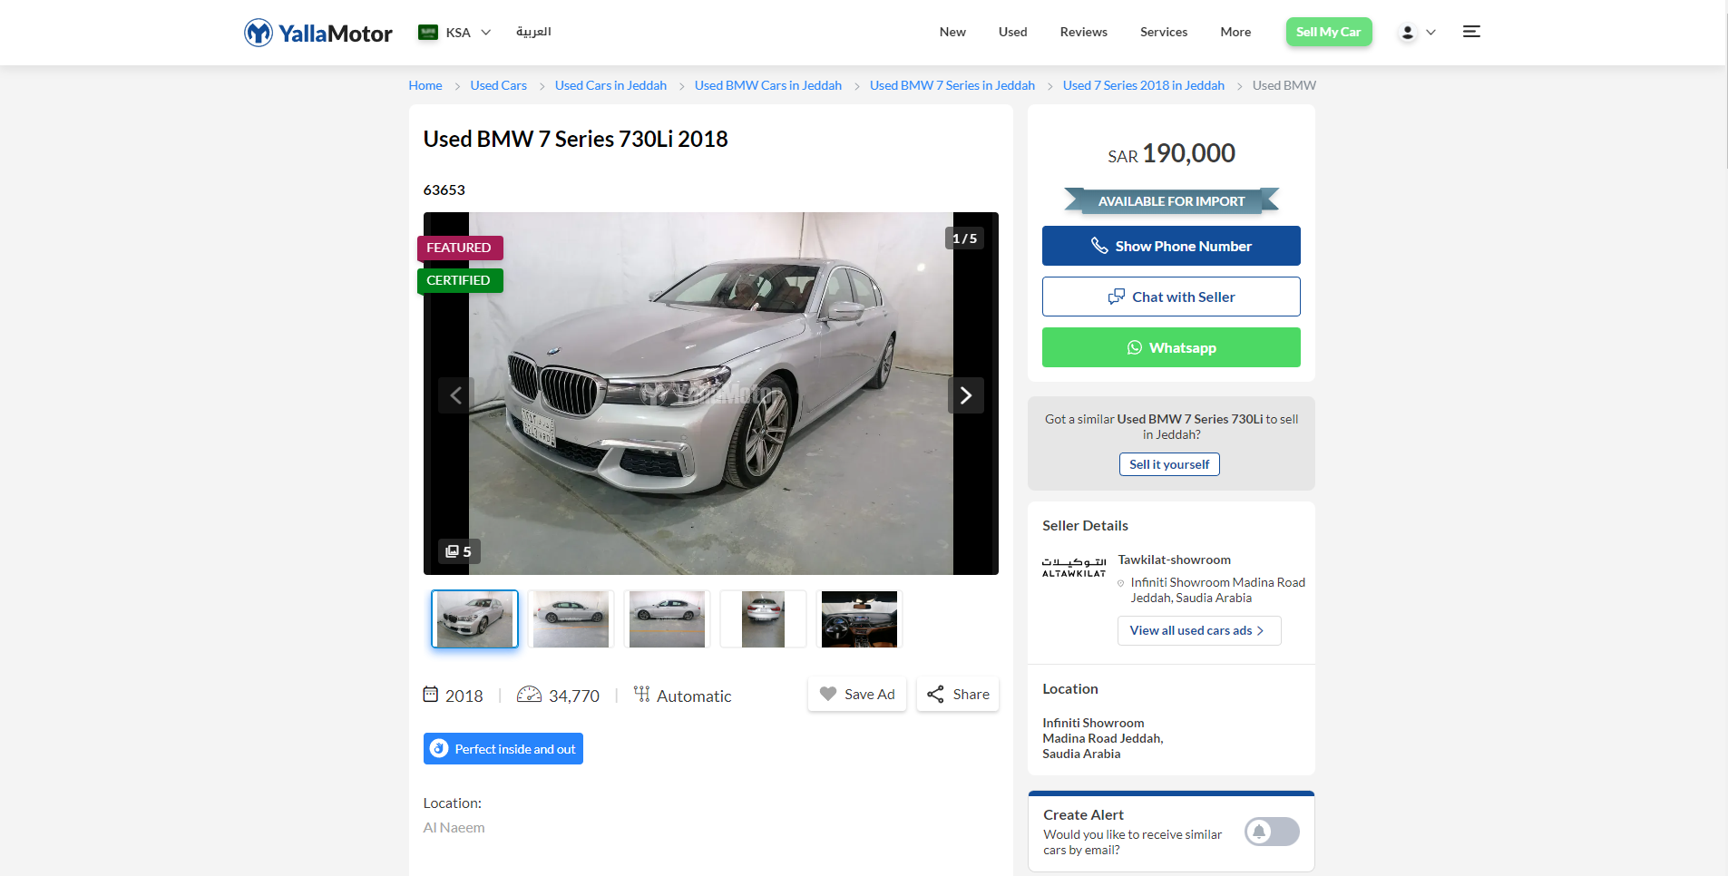
Data Collection
Data was scraped from Yallamotor.com using BeautifulSoup and cloudscraper
The website has around 9000 used cars for sale in KSA
13 features were extracted with a total of 4260 records
Websites that I wanted to use as a data source but couldn’t
Saudisale.com
Haraj.com

Slide 6
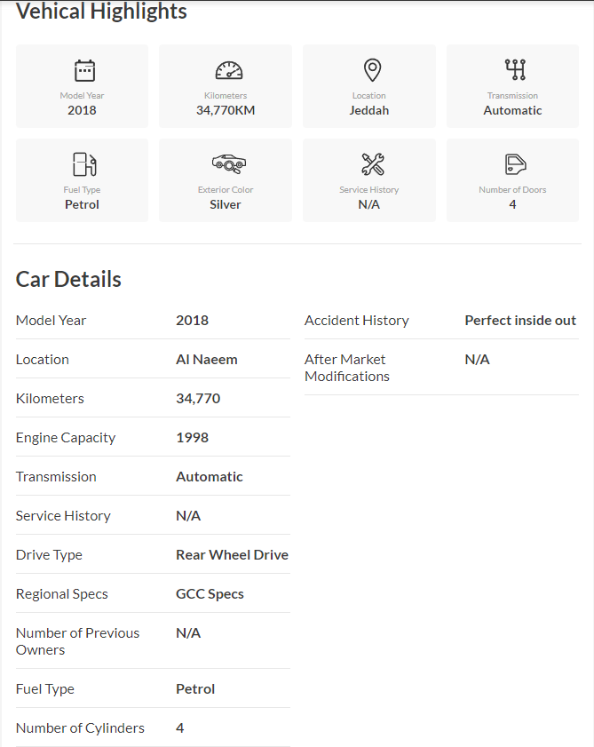
Overview of car features listed in yallamotor.com
Data Collection

Slide 7
Assumptions made on the data
Data covers important features of the car
Color & engine size features is influences car price
Data may have mistyped information like (price, km, etc.)
Data may be only focused on a particular car make

Slide 8
Data Pre-Processing
Data Description:
Name | Description
car_make | Manufacturer of the car
car_model | Model of the car
model_year | Model year
km | Odometers of the car
transmission | Type of transmission (Auto, manual, etc..)
fuel | Type of fuel (petrol or diesel)
color | Color of the car
no_doors | Number of doors
engine_capacity | Engine size in CC
no_cylinders | Number of cylinders
Accident_history | Accidents history (Perfect, minor, major or normal wear and tear)
price | Price of used car

Slide 9
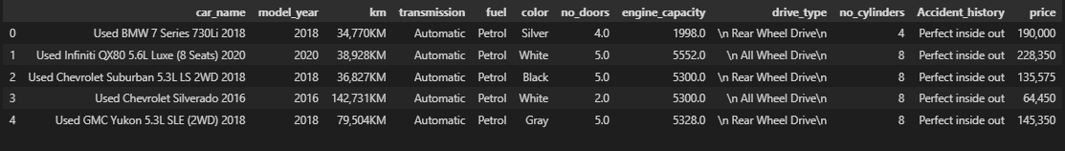
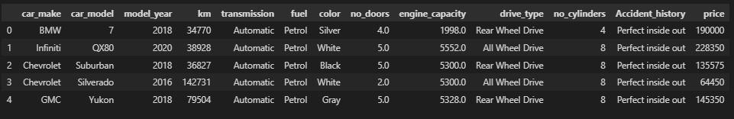
Data Pre-Processing
Data Cleaning:
Before :
After :

Slide 10

Model Building
R2 scores:
 | Train (R2 score) | Test (R2 score)
Before hyperparameter tuning | 0.85 | 0.83
After hyperparameter tuning | 0.95 | 0.89
XGBRegressor
Tested multiple models and XGBRegressor outperformed them all
Used RandomizedSearchCV for hyperparameter tuning
Preformed cross validation with 5 Kfolds
Cross validation:

Slide 11

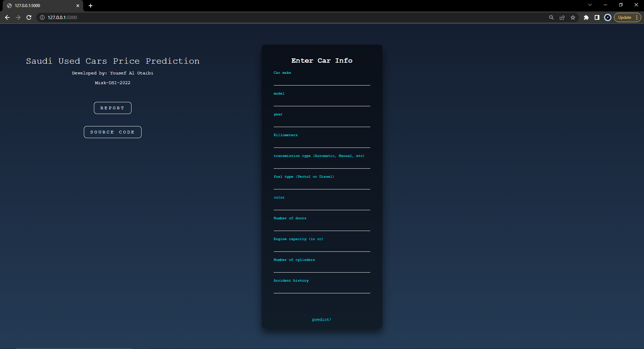
Model Deployment
Model was deployed with Flask
We’ll take a quick demo after the presentation..

Slide 12
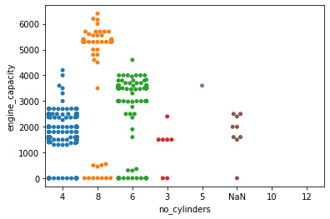
Challenges in Data Cleaning
Swarm Plot for engine_capacity and no_cylinders
Swarm plot shows that a lot of our engine_capacity values are entered wrong.
Values with engine capacity less than a 1000 is mistyped, as it’s nearly impossible to have and engine capacity less than 1000.
It's known that engine capacity increases with more number of cylinders, but in our graph it didn't, an engine with 4-cylinders had an engine capacity more than 4000 which lead me to conclude that the quality of the data is poor in terms of engine capacity.

Slide 13
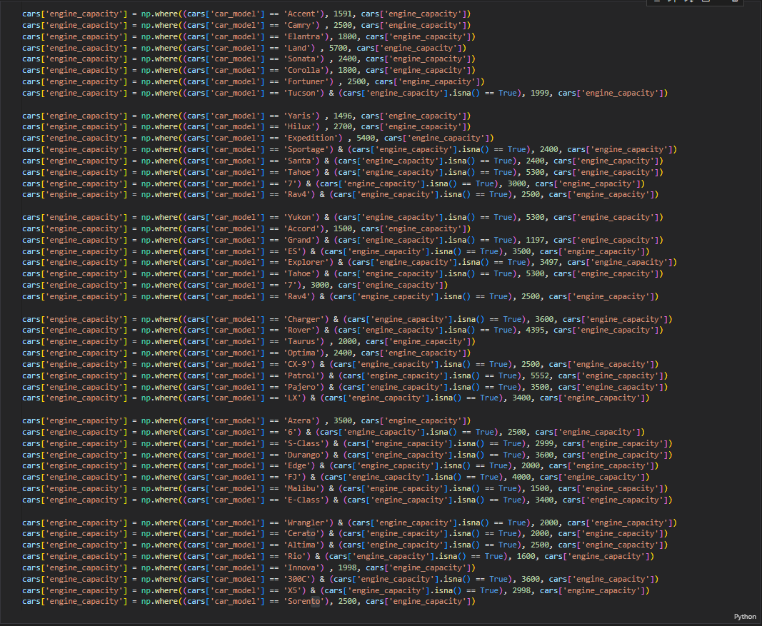
Challenges in Data Cleaning
1.
To resolve this issue I’ve done two things:
Replace engine capacities one by one for the car models that have NaN and value count more than 20, drop any engine_capacity less than 1000.
Note : cars with missing engine capacity don't specify the class of the car_model which makes me assume that it's standard (standard engine_capacity), also some car models come in one engine capacity, so I changed all their values including Nan

Slide 14
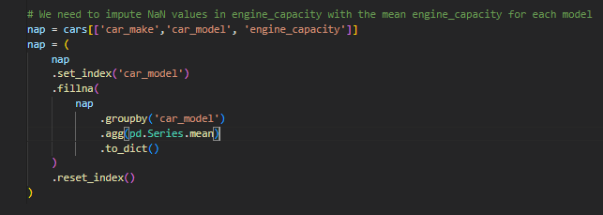
Challenges in Data Cleaning
2.
Filling engine_capacity NaN values with the mean in each car_model
To resolve this issue I’ve done two things:
Replace engine capacities one by one for the car models that have NaN and value count more than 20, drop any engine_capacity less than 1000.
Filling the rest of the NaN values in engine_capacity with the mean engine_capacity for each model.
There are around 500 NaN values of models with all engine_capacity values as NaN, So we replace them with the mean

Slide 15
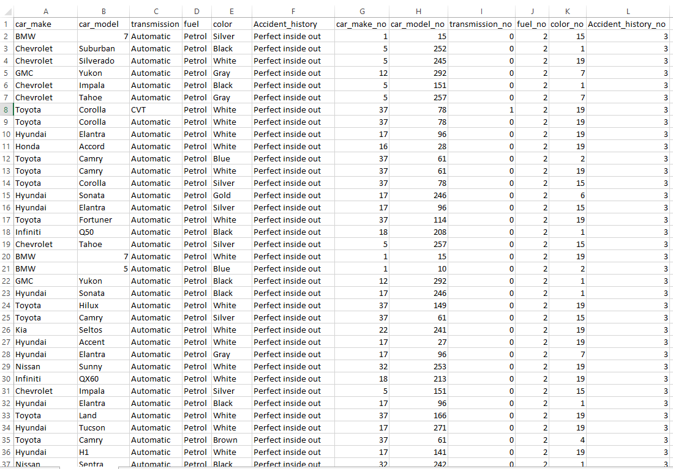
Challenges in Model Deployment
Data set for categorical variables reference
Linking the input of categorical variables to a table with their label number
Steps:
Encode categorical variables
Make a table and store encoded variables of car_make and car_model with their cross bonding car_make and car_model names
Use it as a reference when receiving input to search for the input values

Slide 16

Limitations
TIME
Poor data quality

Slide 17
Future work
Enhance the website GUI
Expand the scope and size of the data, get a more reliable data source
Improve model accuracy
Add dashboards to the website
Publish the website

Slide 18


Slide 19


